Slide 1


Data Engineering, Detection Engineering, and SecDataOps : Where the Magic (and Chaos?) Happens!
25th February 2025
Digit Oktavianto
https://threathunting.id

Slide 2
Introduction
Infosec Consulting Manager
Co-Founder BlueTeam.ID (https://blueteam.id)
Born to be DFIR Team
Community Lead @ Cyber Defense Community Indonesia
Member of Indonesia Honeynet Project
Opreker and Researcher
{GEIR | GCIH | GMON | GCFE | GICSP | CEH | CSA | ECSA | ECIH | CHFI | CTIA | ECSS | eCIR | eCTHP | eCMAP} Certifications Holder

Slide 3
Agenda
Problem Statement
Modern SOC Platform
Data Engineering
Detection Engineering
SecDataOps

Slide 4
Problem Statement
Are you facing these challenges in data and security engineering in your security operations (SecOps)?
Overwhelmed by massive security data? Managing vast amounts of logs and telemetry is complex, but limited storage and indexing make it even harder.
Struggling with SIEM licensing and costs? High ingestion rates drive up expenses, forcing difficult choices on what data to retain.
Detection engineering bottlenecks? Writing and maintaining detection rules is challenging without a structured approach to data normalization.
Lack of efficient data pipelines? Inconsistent or unstructured logs make correlation, enrichment, and analysis a nightmare.
Slow threat detection and response? Security teams are drowning in false positives or missing critical alerts due to ineffective data processing.
Building vs. buying dilemma? Should you invest in a SecDataOps platform, or build your own data pipelines for scalable security analytics?

Slide 5
Modern SOC

Slide 6
What Makes a Modern SOC
Is it because of the Technology? (NG-SIEM, AI/ML, SOAR, UEBA, EDR, NDR, CTI)
Is it because of the Service in SOC? (Threat Intelligence Driven, Threat Hunting, Detection as a Code, Fraud Detection, Continuous Security Validation)
Is it because of the Scope of Asset monitored in SOC? (Cloud Environment, Big Data, IoT / OT)
Is it because of the people and roles in SOC? (Threat Hunter, CTI Analyst, Detection / Content Engineer, Purple Team)

Slide 7
What Makes a Modern SOC
Bringing technology into the conversation, security orchestration, automation and response is a common tool used by modern SOCs, and it is key to providing mature SOC services. This is especially true for services such as incident response, which are very time dependent. Automation doesn’t have to be complex. For example, simply automating how data is shared between tools so a SOC analyst doesn’t have to log in to multiple tools can give valuable time back to the team.
Four areas are popular for automation:
Enrichment: Improving data, eliminating manual pivots and automating workflows leading to verdicts.
Response: Automating outcomes such as preventing access to a system or removing a file.
Threat hunting: Taking different datapoints and using them to identify threats.
Cyber hygiene. Automating vulnerability management, posture and configurations
https://blogs.cisco.com/security/the-modern-security-operation-center

Slide 8
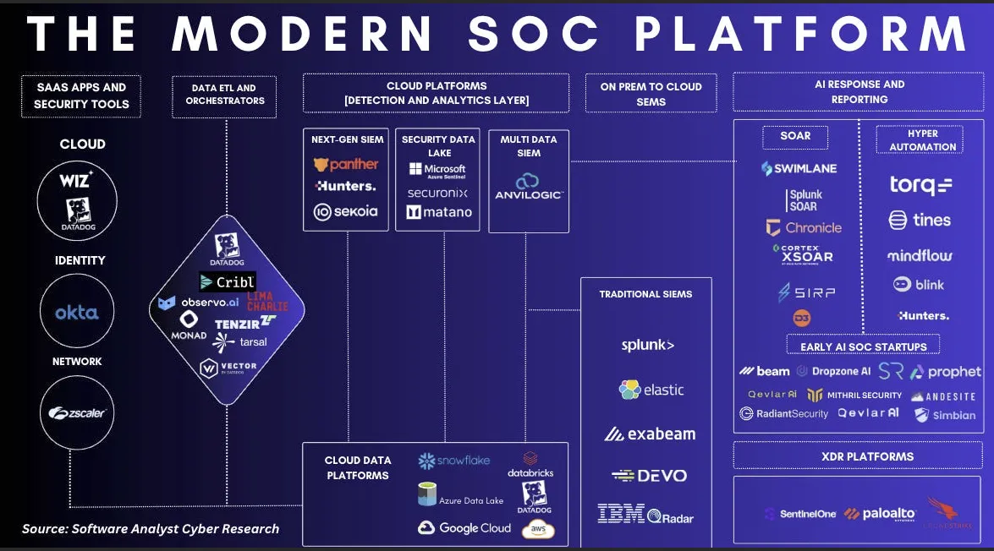
Modern SOC Platform
The Modern SOC Platform. Image taken from https://softwareanalyst.substack.com/p/the-future-of-soc-automation-platforms

Slide 9
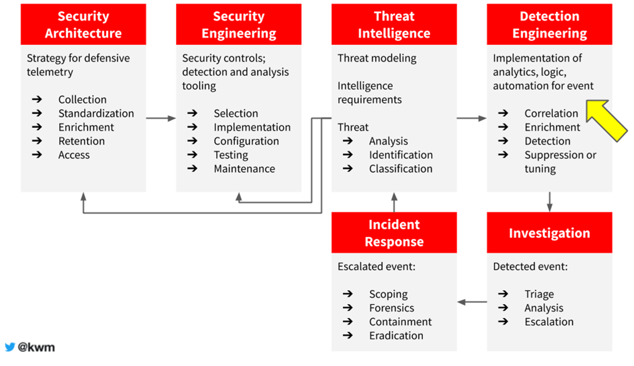
Modern Threat Analysis, Detection, and Response
https://x.com/kwm/status/1260599938590797824

Slide 10
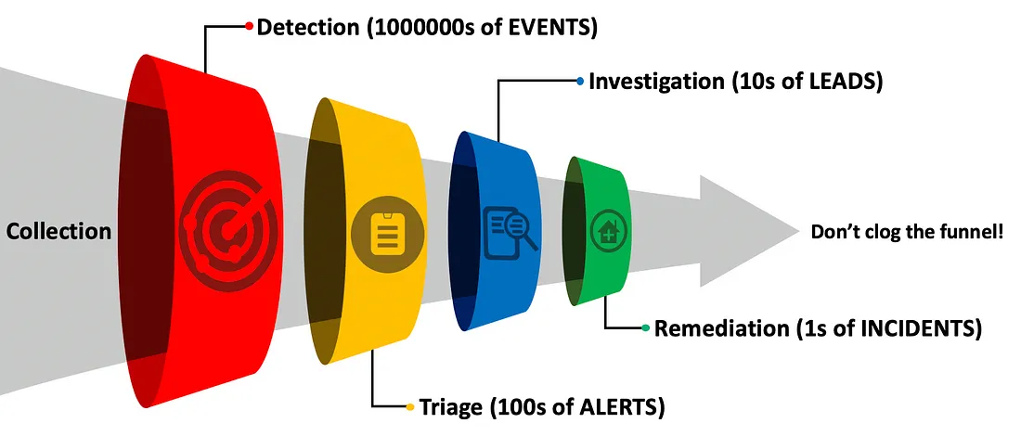
The Funnel of Fidelity
https://posts.specterops.io/introducing-the-funnel-of-fidelity-b1bb59b04036

Slide 11
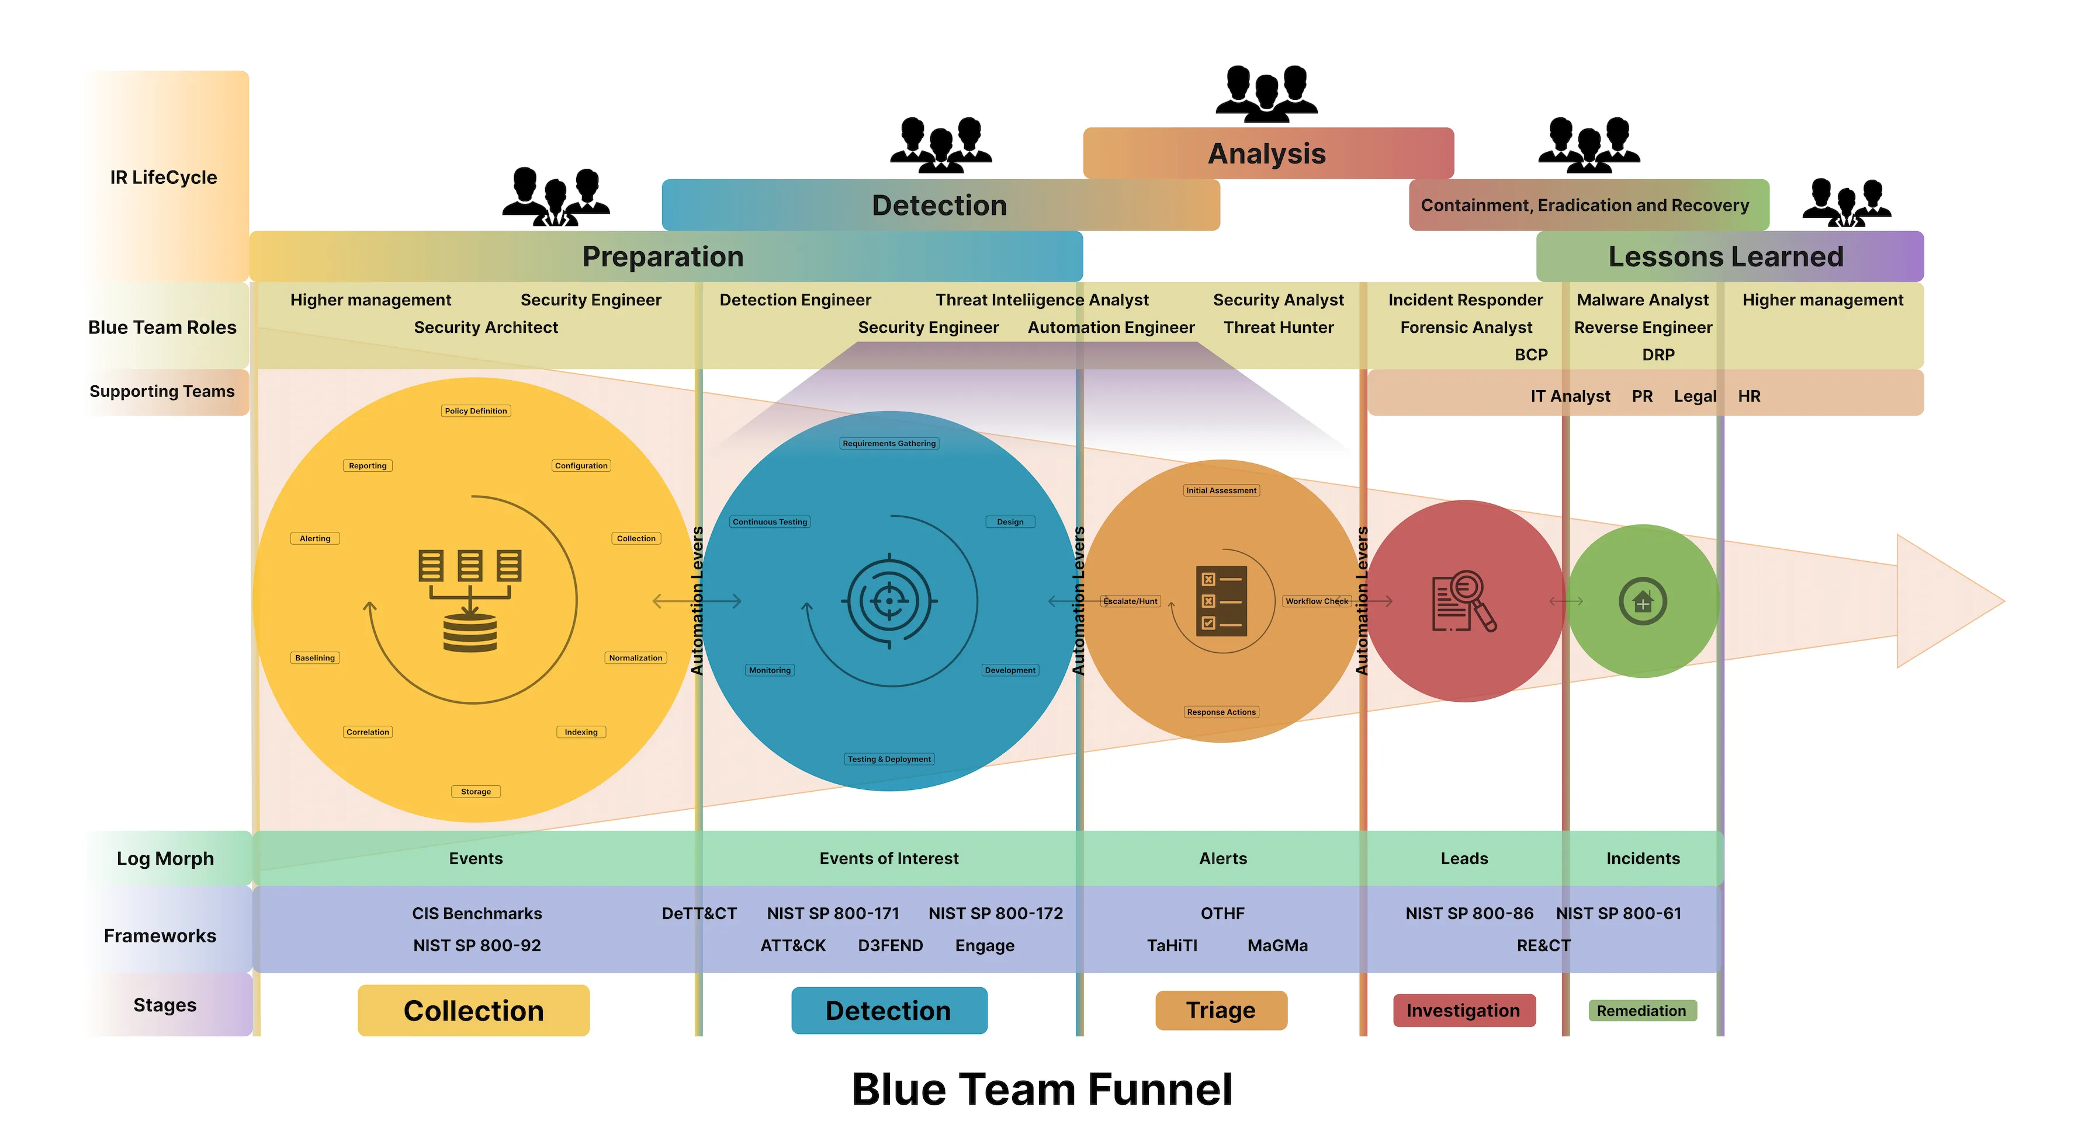
Blue Team Funnel
https://d4rkciph3r.medium.com/establishing-a-detection-engineering-program-from-the-ground-up-b170811166c

Slide 12
Data Engineering
From IBM Website (as reference) :
“Data engineering is the practice of designing and building systems for the aggregation, storage and analysis of data at scale. Data engineers empower organizations to get insights in real time from large datasets.”
A data engineer is someone who is responsible for collecting, processing, managing, and storing data from various different sources so that it can support the business processes that require it. In general, he is tasked with building a system or infrastructure so that the data that has been collected can be used by data analysts and data scientists quickly and easily.

Slide 13
Data Engineering

Slide 14
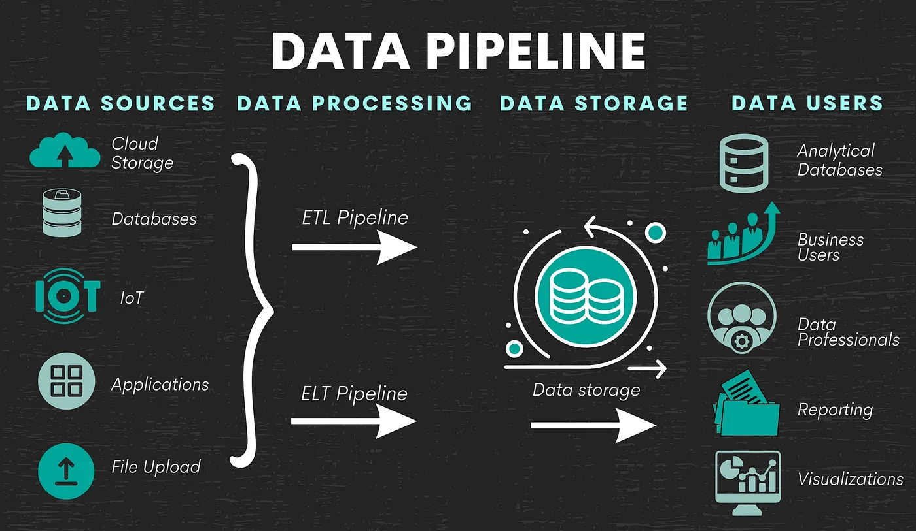
Data Engineering Pipeline Process
Data Engineering Pipeline Process. Image Taken From : https://www.stratascratch.com/blog/what-does-a-data-engineer-do-and-what-they-dont-do/

Slide 15
Data Pipeline
Data pipeline is a data processing stage. It starts from the data source. From there, the data will be processed. At the end of the pipeline, it ends up at a destination. The data at the estuary has been processed. However, it could be raw data for something else.
Don’t forget after the data is processed, they will be stored somewhere. The data in Data Engineering is also store it in a structured way so that it can be used effectively.
Without this stage, data would be scattered and unusable. At some point, the data need to be correlated, enrich, adding the context, combine with other things so whoever the end user who utilized the data, they can get the benefit from a good data engineering pipeline process.

Slide 16
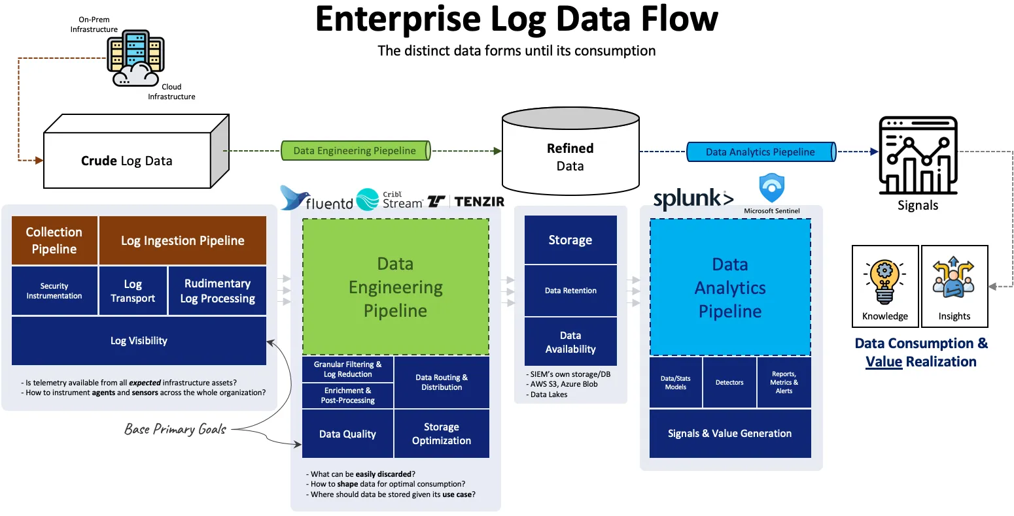
https://detect.fyi/why-you-need-data-engineering-pipelines-before-an-enterprise-siem-0be553584aa9

Slide 17
Data Engineering Before Detection Engineering
Data Engineering is the practice of designing and building systems for collecting, storing, and analyzing data at scale.
A data pipeline merges technologies and workflows that transfer data between platforms to enable storage and subsequent analysis.
The diagram above emphasizes a crucial yet frequently overlooked element in enterprise SIEM deployments: effective management of incoming data pipelines.

Slide 18
Data Engineering in Cyber Security
Security relies heavily on data—without consistent access to security telemetry, organizations can't verify proper system configurations, identify threats, or conduct incident investigations.
One of the most significant hurdles for security teams is determining which data to collect, how much to retain, and the appropriate retention period. The challenge is undeniable: there's no way to predict how long it might take to uncover a breach.
If an investigation requires looking back one or two years, the necessary data must be available to reconstruct events, assess the full impact, and implement remediation. Since it's impossible to foresee what information might be crucial in the future, the most straightforward approach is to collect everything and store it indefinitely.
This growing demand for large-scale data retention has opened the door for numerous vendors to offer solutions for data collection, consolidation, storage, historical threat analysis, detection engineering, and other related challenges.

Slide 19
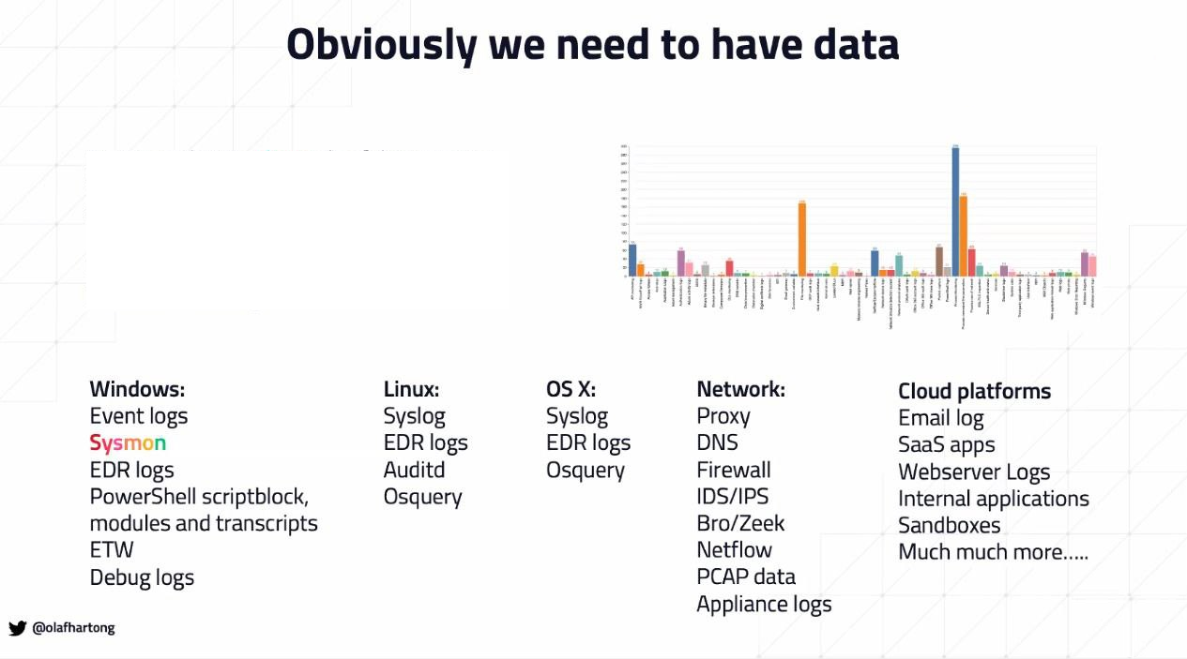
Data… Data… Data….

Slide 20
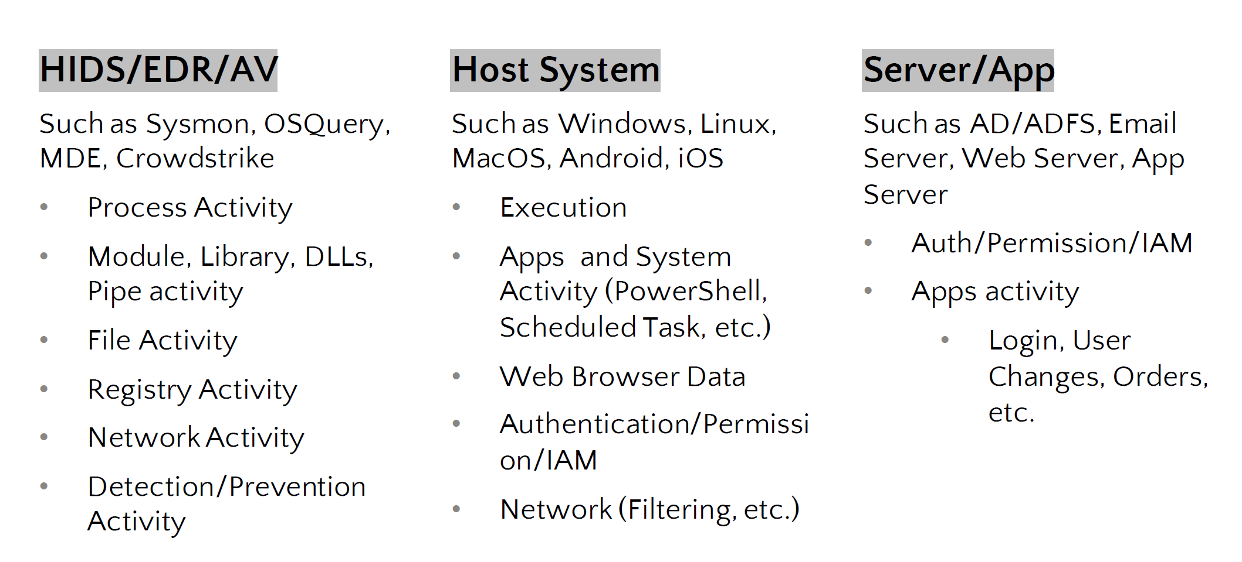
Endpoint Telemetry
Detection Engineering In Modern Day Security Organization by Tondang Mangatas and Sylvain Lu
https://www.youtube.com/watch?v=Q5uR-XePEYE

Slide 21
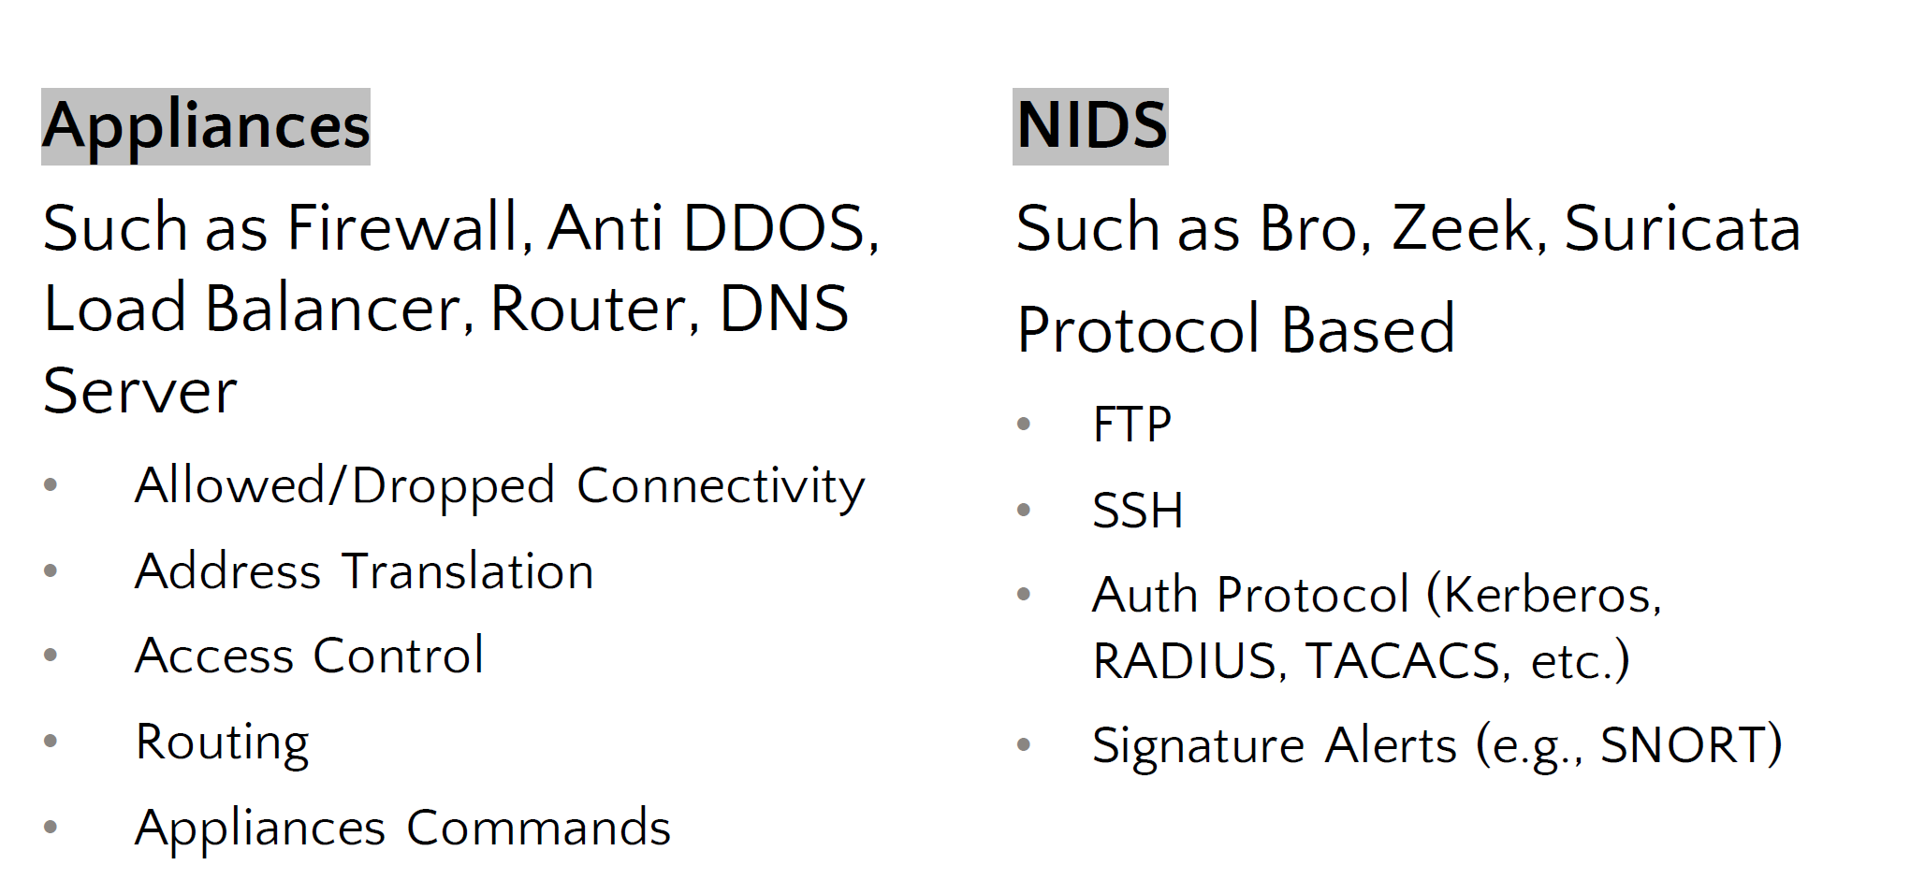
Network & Network Security Telemetry
Detection Engineering In Modern Day Security Organization by Tondang Mangatas and Sylvain Lu
https://www.youtube.com/watch?v=Q5uR-XePEYE

Slide 22
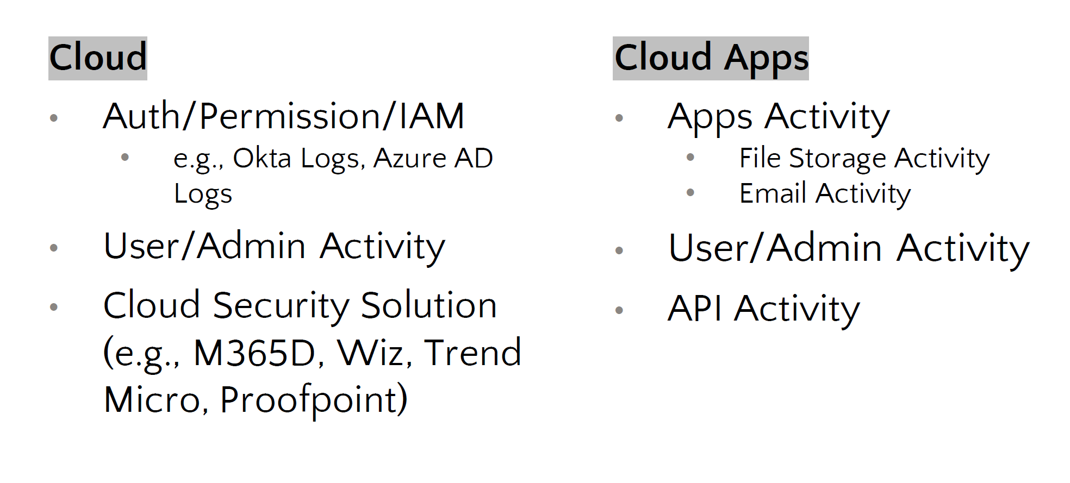
Cloud Telemetry
Detection Engineering In Modern Day Security Organization by Tondang Mangatas and Sylvain Lu
https://www.youtube.com/watch?v=Q5uR-XePEYE

Slide 23
Detection Engineering

Slide 24
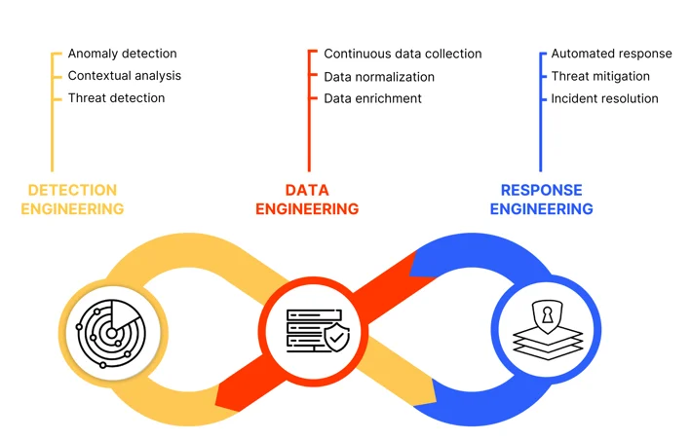
Detection Engineering, Data Engineering, and Response
https://netenrich.com/guides/managed-detection-and-response-guide

Slide 25
Detection Engineering
Detection engineering is a set of practices and systems to deliver modern and effective threat detection.
When building a solid detection engineering, the main goal is to catch malicious things and to not catch too many not malicious things.
If the detection system interrupt an analyst’s activities because calling attention to things that are not malicious, then you’re creating more work for the analysts.
Detection products only create value by detecting things that are truly bad, and most detection products lean towards detecting more activity so as to not miss anything.

Slide 26
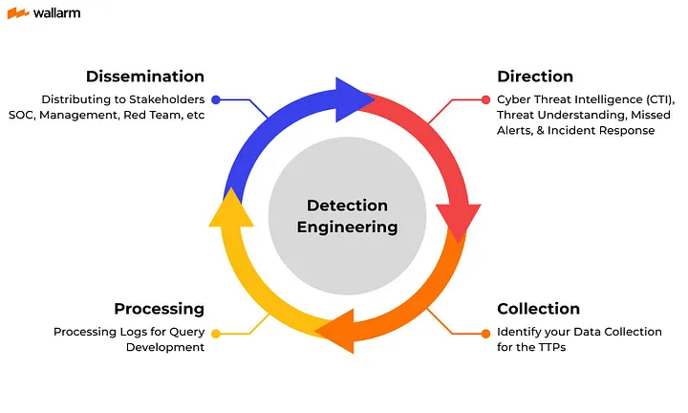
Detection Engineering in a Cycle
https://www.wallarm.com/what/detection-engineering

Slide 27
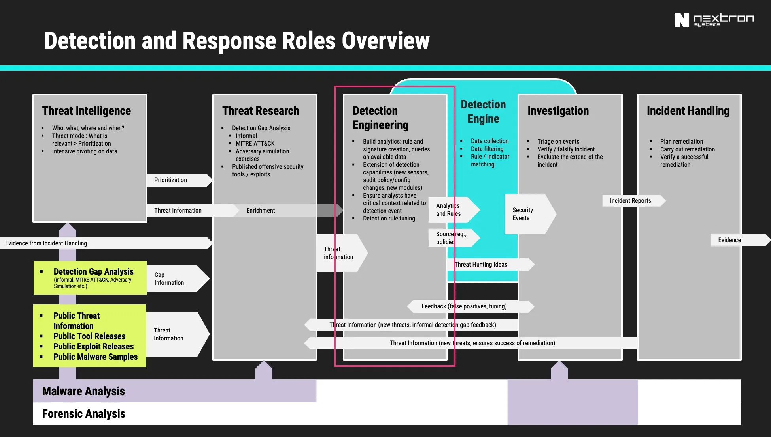
Detection and Response Roles Overview
https://cyb3rops.medium.com/about-detection-engineering-44d39e0755f0

Slide 28
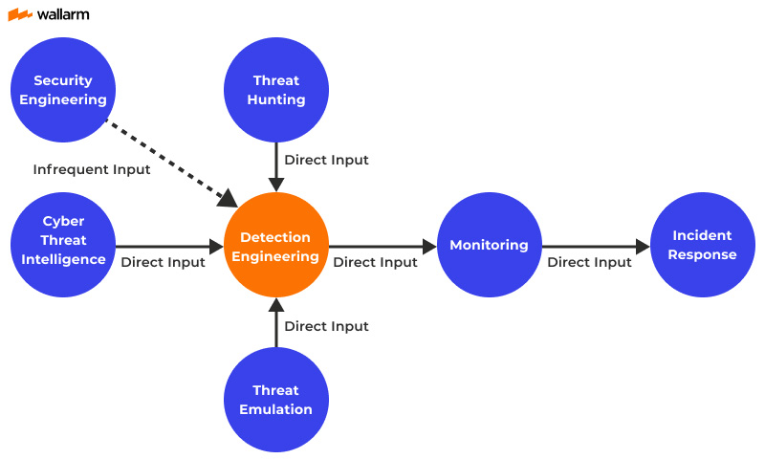
Relationship Between Detection Engineering and Other Entities
https://www.wallarm.com/what/detection-engineering

Slide 29
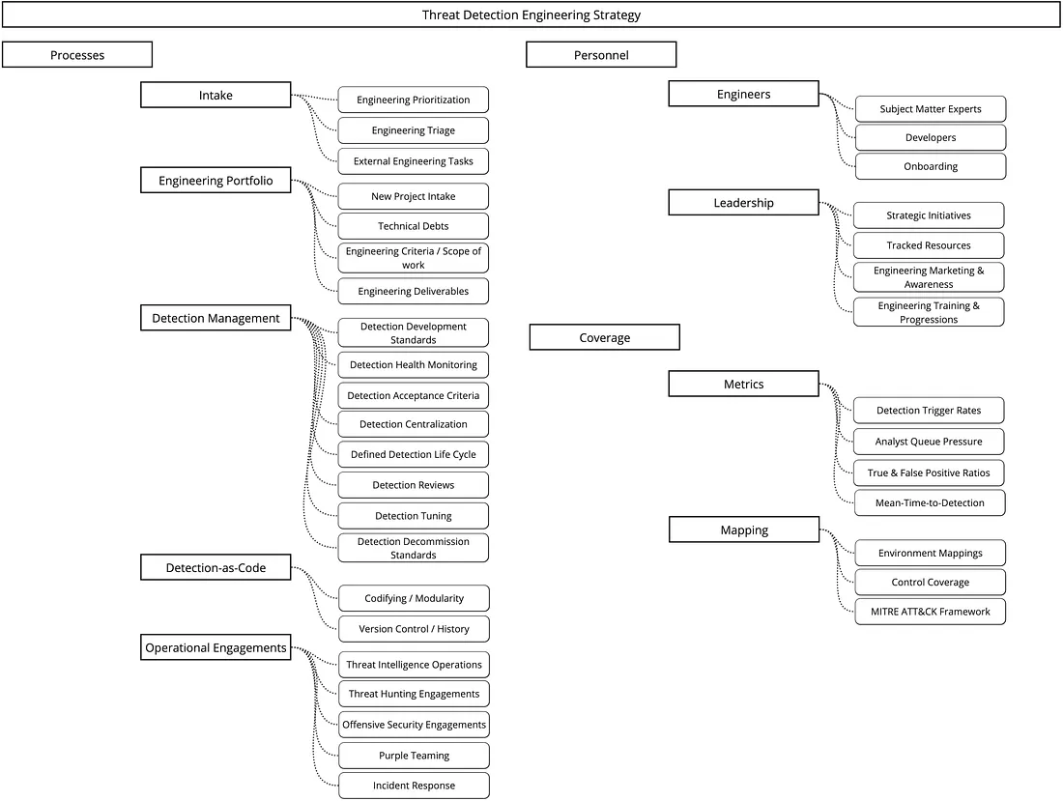
Threat Detection Engineering Strategy
https://medium.com/@harrisonpomeroy/assessing-a-detection-engineering-program-for-maturity-b896955bba66

Slide 30
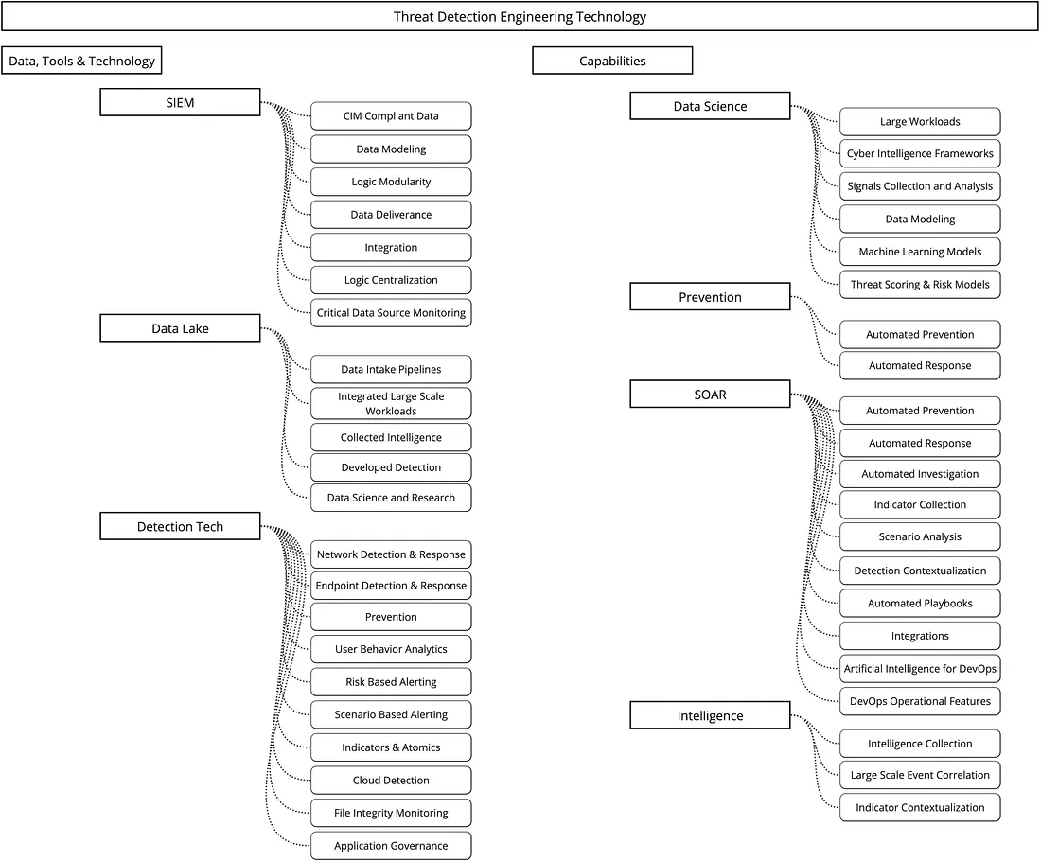
Threat Detection Engineering Technology
https://medium.com/@harrisonpomeroy/assessing-a-detection-engineering-program-for-maturity-b896955bba66

Slide 31
Challenges in Detection Engineering
Balancing Detection Coverage and False Positives
Too many detections can overwhelm analysts with alerts, leading to alert fatigue.
Too few detections can result in missing real threats (false negatives).
Rapidly Evolving Threat Landscape and Adaptive Threats
Attackers continuously evolve their tactics, techniques, and procedures (TTPs) to bypass detections.
Data Quality and Log Inconsistencies
Security detections rely on high-quality logs, but data can be incomplete, inconsistent, or missing.
Different log sources (SIEM, EDR, NDR, cloud services) may have variations in format, making normalization and correlation challenging.
Integration with Security Operations (SecOps)
Collaboration between detection engineers, threat hunters, and SOC analysts is key to improving overall security posture.
Resource and Skill Constraints
Developing high-quality detections requires deep knowledge of cybersecurity, data science, and scripting.

Slide 32
Introduction to SecDataOps
SecDataOps acts as the backbone which connects and streamlines all aspects of modern security operations.
It revolves around developing purpose-built data pipelines that efficiently gather, standardize, enrich, contextualize, and distribute security data, and also ensuring large-scale information remains manageable and actionable.
A fundamental concept in SecDataOps is modular pipeline design, enabling security teams to rapidly assemble and customize data workflows by linking different components.
This flexible approach improves agility, optimizes resource utilization, and minimizes reliance on rigid, high-maintenance SIEM platforms.

Slide 33
SecDataOps

Slide 34
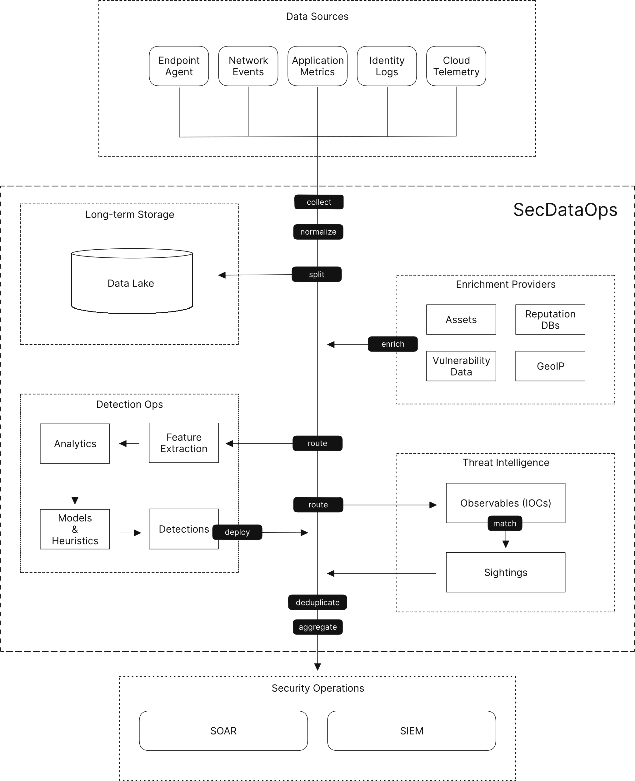
SecDataOps Pipeline Example
https://tenzir.com/secdataops

Slide 35
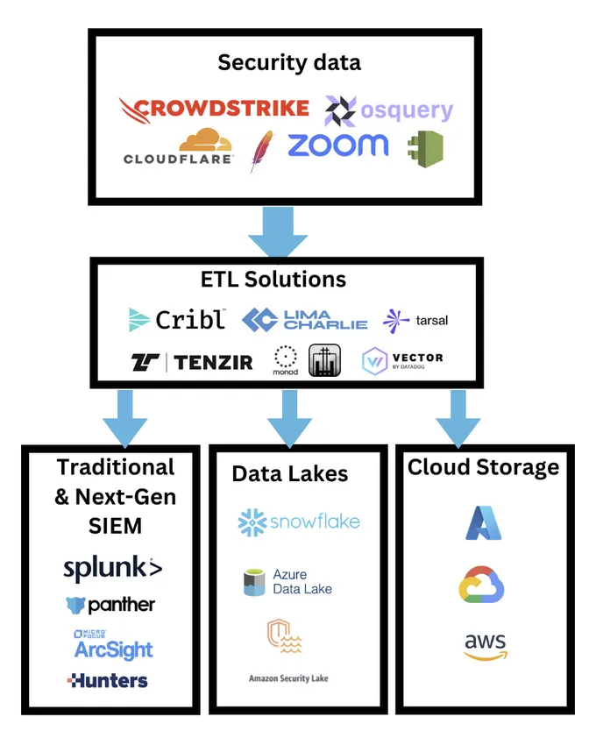
SecDataOps Positioning

Slide 36
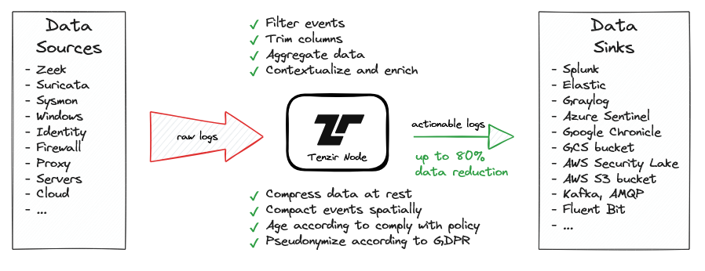
Use Case SecDataOps 1 : Optimze SIEM Cost
https://docs.tenzir.com/use-cases/optimize-siem-costs

Slide 37
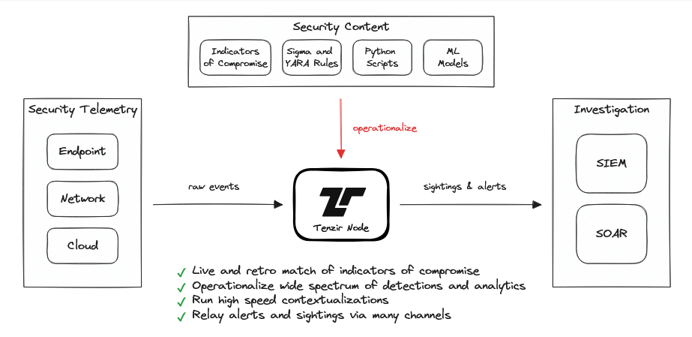
Use Case SecDataOps 2 : Enrichment and Contextualization
https://docs.tenzir.com/use-cases/execute-detections-and-analytics

Slide 38
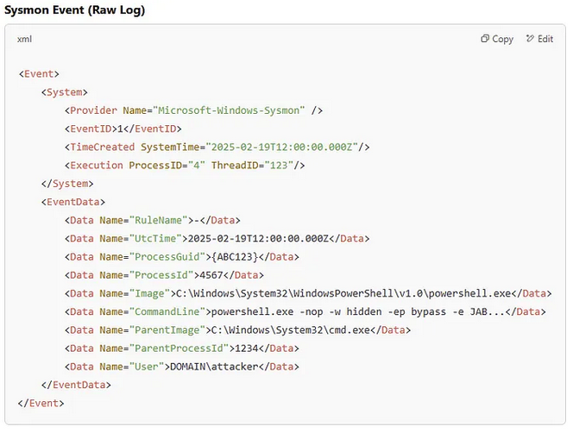
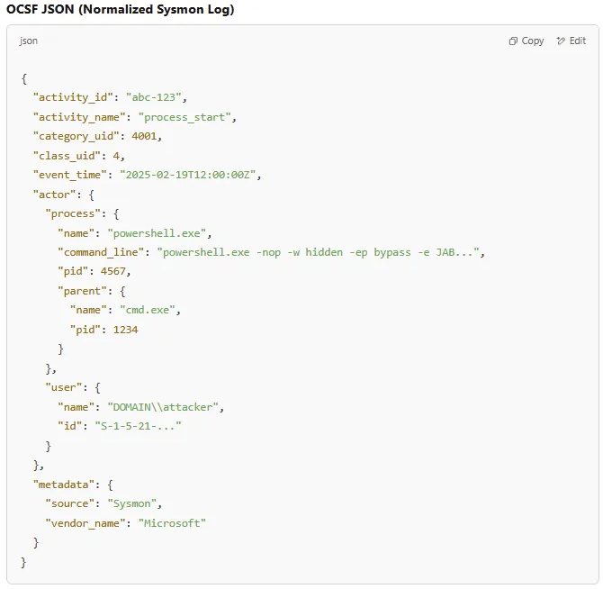
Example Case Study ….. (1)

Slide 39
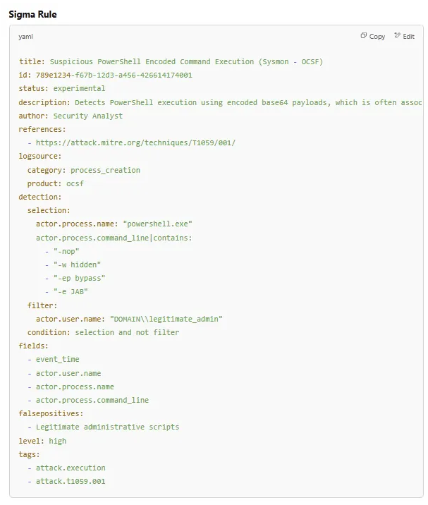
Example Case Study ….. (2)

Slide 40
How SecDataOps Helps Detection Engineering Process
SecDataOps enhances detection engineering by:
Decoupling Detection Logic from SIEM Correlation Rules — Instead of relying solely on static SIEM rules, detections can be applied directly within the SecDataOps pipeline, allowing for real-time enrichment, contextualization, and advanced behavioral analytics before the data reaches the SIEM.
Leveraging Open Standards for Detection Consistency — By normalizing security logs into open frameworks like OCSF, detection engineers can create portable detection logic that works across multiple platforms, improving interoperability and reducing the dependency on vendor-specific SIEM models.
Enhancing Threat Detection with Streaming Analytics — Real-time data streaming and processing within SecDataOps enables immediate anomaly detection, reducing dwell time and allowing SOC teams to proactively hunt for threats instead of waiting for SIEM alerts.
Optimizing False Positive Reduction & Rule Tuning — With pre-ingestion data filtering, enrichment, and tagging, analysts can apply refined detection rules with higher accuracy, reducing unnecessary noise and improving response efficiency.

Slide 41
Importance of SecDataOps
Data Volume Reduction
Filtering & Sampling: remove low-value or redundant data (e.g., debug logs, duplicate events) before it reaches the SIEM. It applies field reduction, sampling, and aggregation to shrink data volume by 30–80%
Edge preprocessing to filter irrelevant data (e.g., non-security logs) and deduplicate events
Result: Lower SIEM licensing fees (typically based on ingest volume) and reduced storage costs
Decoupling Storage and Compute
Cost-Effective Storage: Route raw logs to SecDataOps Platform (compressed, low-cost storage) instead of the SIEM. Only critical data (e.g., alerts, enriched events) is sent to the SIEM for analysis
Result: Avoid paying SIEM licensing fees for non-critical data while retaining forensic access

Slide 42
Importance of SecDataOps
Data Normalization & Enrichment
Schema Standardization: SecDataOps Platform map raw logs to OCSF or ECS, reducing SIEM parsing overhead.
Edge Enrichment: Add context (e.g., threat intel, asset tags, vulnerability management information, etc) at the pipeline stage, avoiding redundant processing in the SIEM
Result: Faster SIEM performance and reduced compute costs
Preprocessing at the Edge
SecDataOps Platform process data at the source (e.g., endpoints, firewalls) to:
Strip unnecessary fields (e.g., debug metadata).
Compress logs using formats like Parquet
Result: Lower network bandwidth costs and reduced SIEM ingest volume

Slide 43
Importance of SecDataOps
Automated Detection at the Pipeline
Detection Execution: SecDataOps runs detection logic (e.g., Sigma rules. Yara rules) in-stream, filtering malicious events before they reach the SIEM
Result: Fewer alerts to triage in the SIEM, reducing analyst workload
Vendor Neutrality & Flexibility
Avoid Lock-In: SecDataOps platform standardize data into open formats (OCSF), enabling multi-SIEM or hybrid architectures (e.g., Splunk + AWS Security Lake)
Result: Flexibility to switch SIEM vendors without reprocessing data

Slide 44
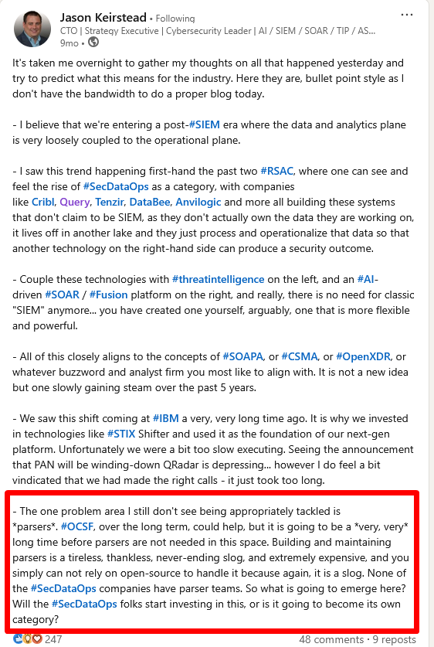
One Last …….
https://www.linkedin.com/posts/jasonkeirstead_siem-rsac-secdataops-activity-7196862839620300802-j65L/

Slide 45
Summary and Key Takeaway
A robust security data pipeline is the backbone of modern threat detection and response workflows. Without a structured pipeline, security teams face data silos, inefficient log processing, and increased costs associated with traditional SIEM solutions.
Detection engineering is the process of designing, implementing, and optimizing high-fidelity detection rules to identify security threats while minimizing false positives. Traditional SIEM-based detection models often struggle with rigid data structures, performance bottlenecks, and costly log ingestion requirements.
A well-architected data pipeline is essential for secops, threat detection, and DFIR investigations. The SecDataOps approach ensures security telemetry is properly ingested, normalized, enriched, and routed to the right detection and analytics platforms.

Slide 46
Reference for Reading
https://softwareanalyst.substack.com/p/no-vendor-consolidation-in-the-soc
https://www.monad.com/blog/data-engineering-for-cybersecurity-part-4#key-data-transformations
https://www.thdpth.com/p/secdataops-bridging-the-gap-between
https://ventureinsecurity.net/p/security-is-about-data-how-different
https://www.detectionatscale.com/p/the-transition-from-monolithic-siems

Slide 47
Quotes
“Prevention is Ideal But Detection is A Must”
Dr. Eric Cole

Slide 48
THANK YOU Q & A

